Slide 1
Cavity Perturbation in 1D waveguide cavity
Yutong Zhao
Oct 1st 2018

Slide 2
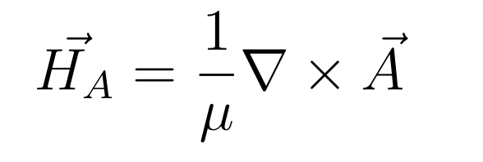
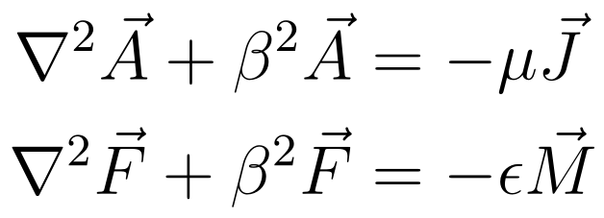
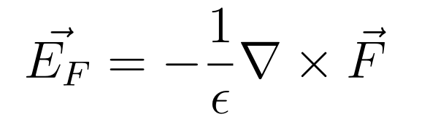
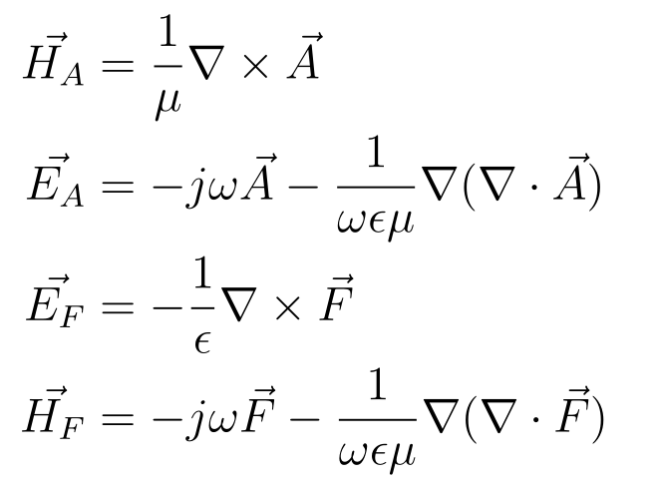
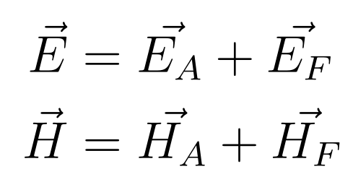
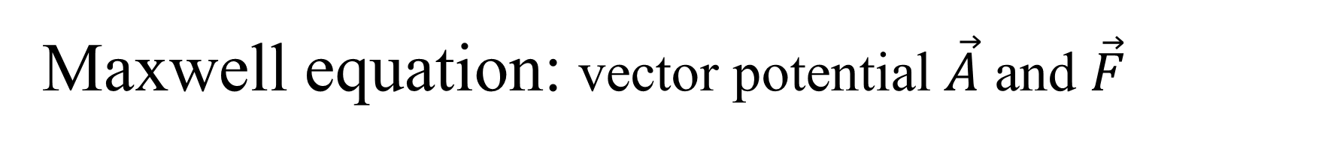
Maxwell equation: vector potential $\vec{A}$ and $\vec{F}$

Slide 3
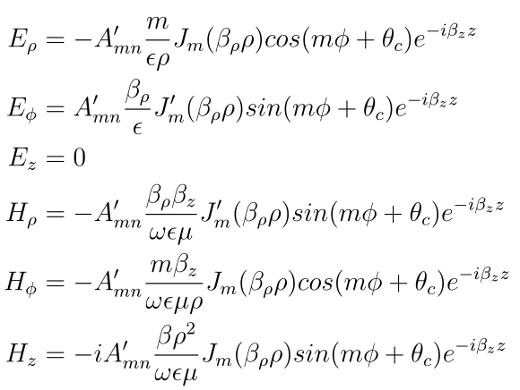


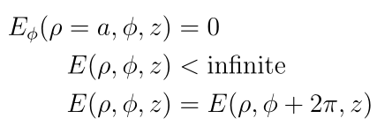
TE_{mn} modes
Boundary condition

Slide 4
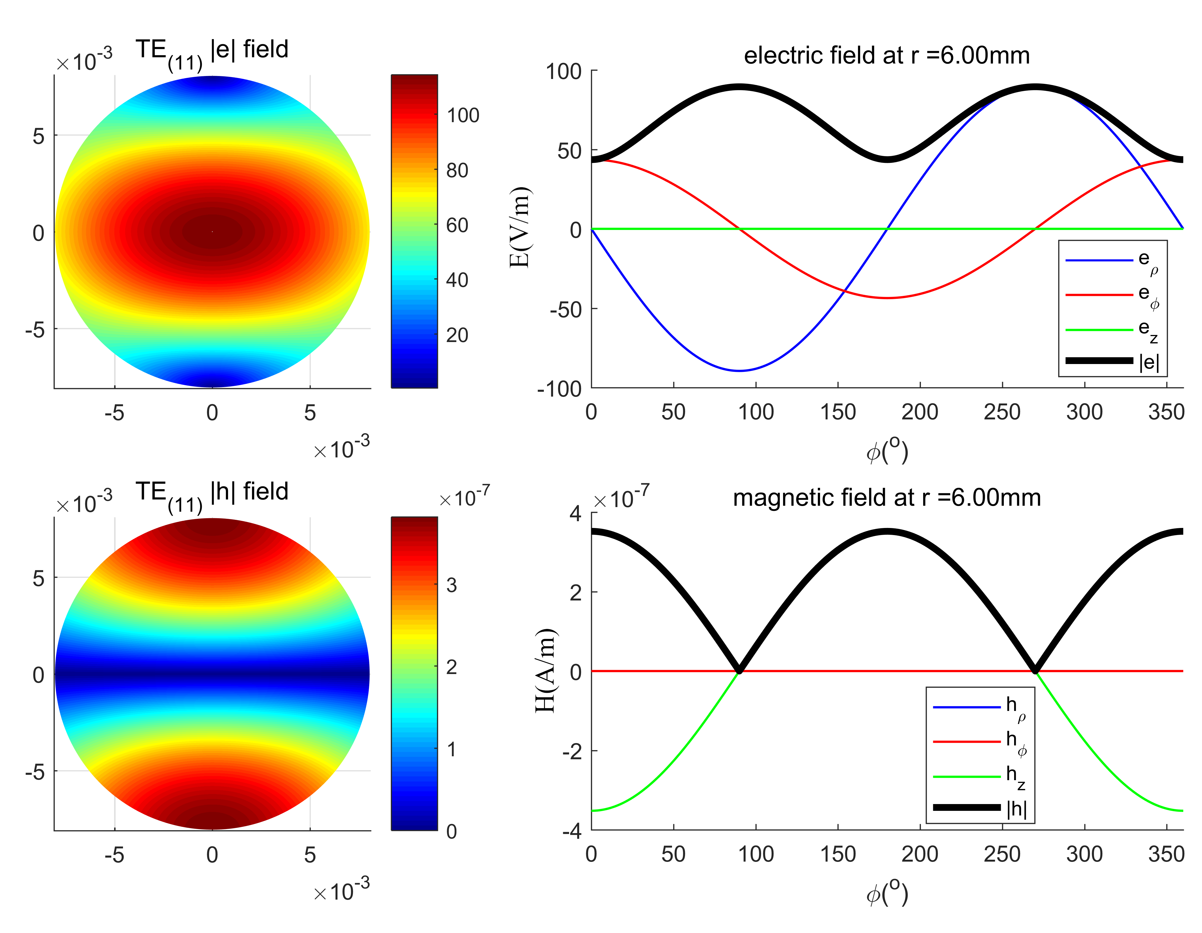
TE₁₁ modes

Slide 5
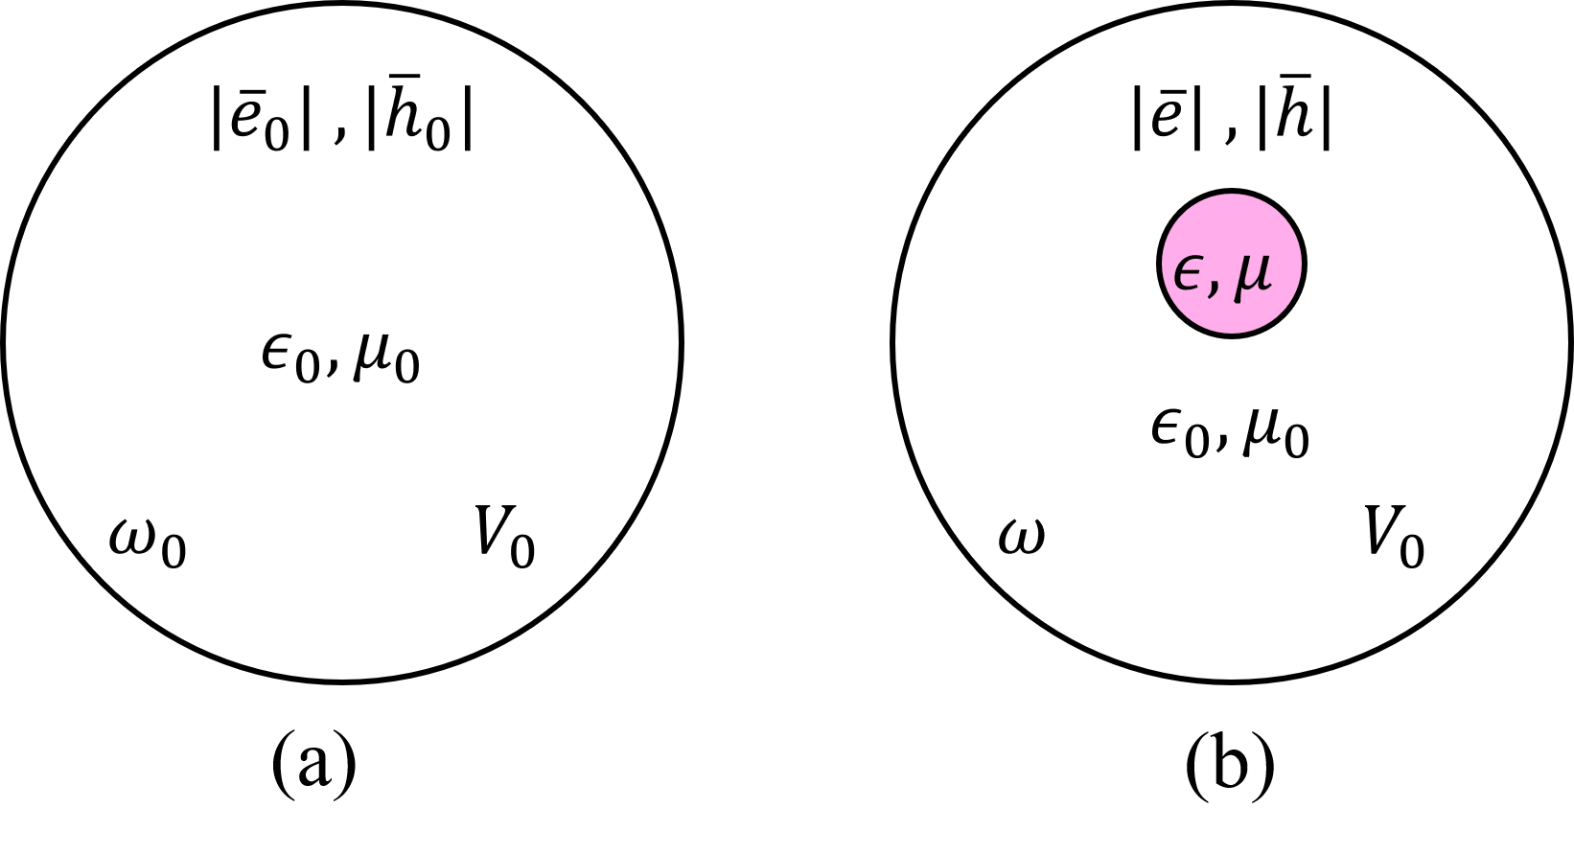
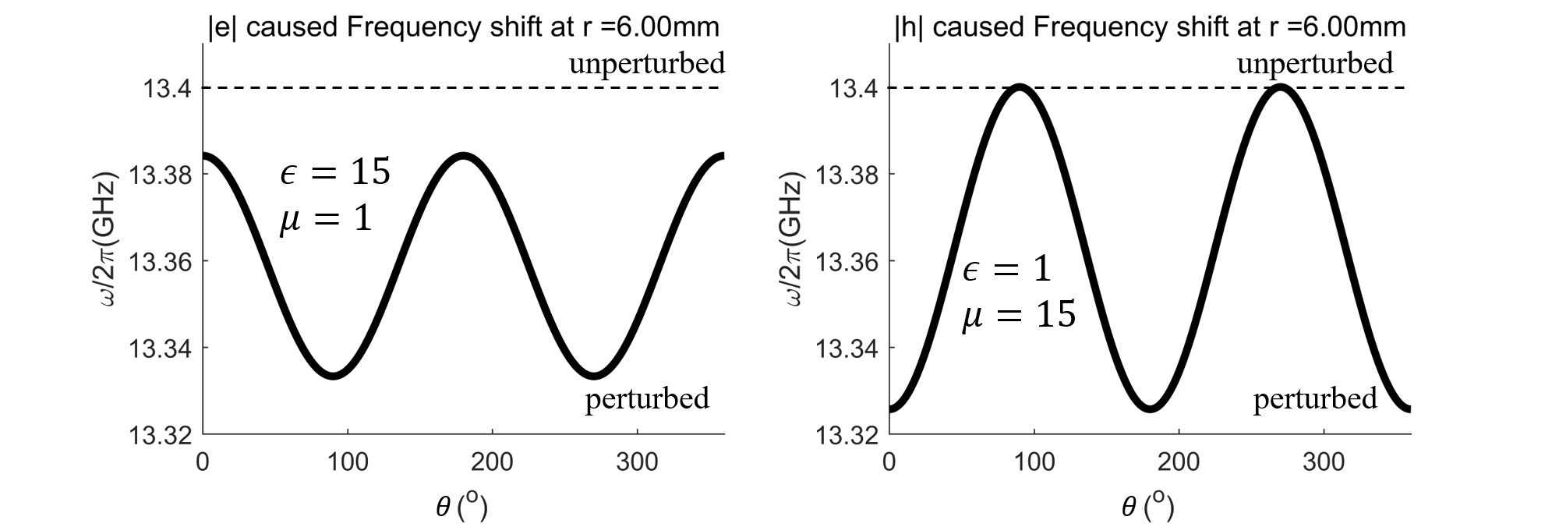
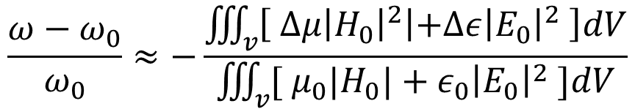


Microwave perturbation theory
$$\frac{ω−ω_{0}}{ω_{0}}≈−\frac{\iiint_{v}{\left[{ Δμ\left|H_{0}\right|}^{2}\left|+Δε\right|E_{0}{\left.​\right|}^{2} \right]dV}}{\iiint_{v}{[{ μ}_{0}|H_{0}|}+ε_{0}{\left|E_{0}\right|}^{2} ]dV}$$
$$φ$$
$$φ$$

Slide 6
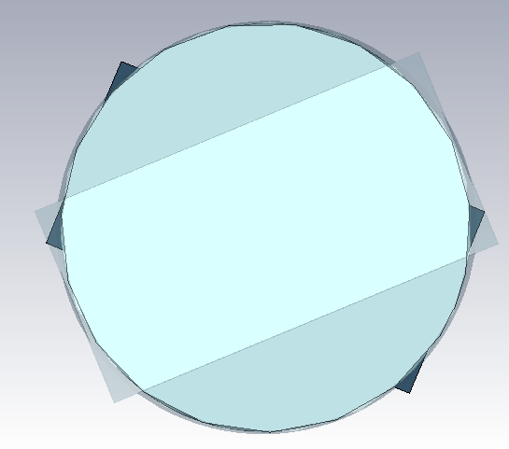
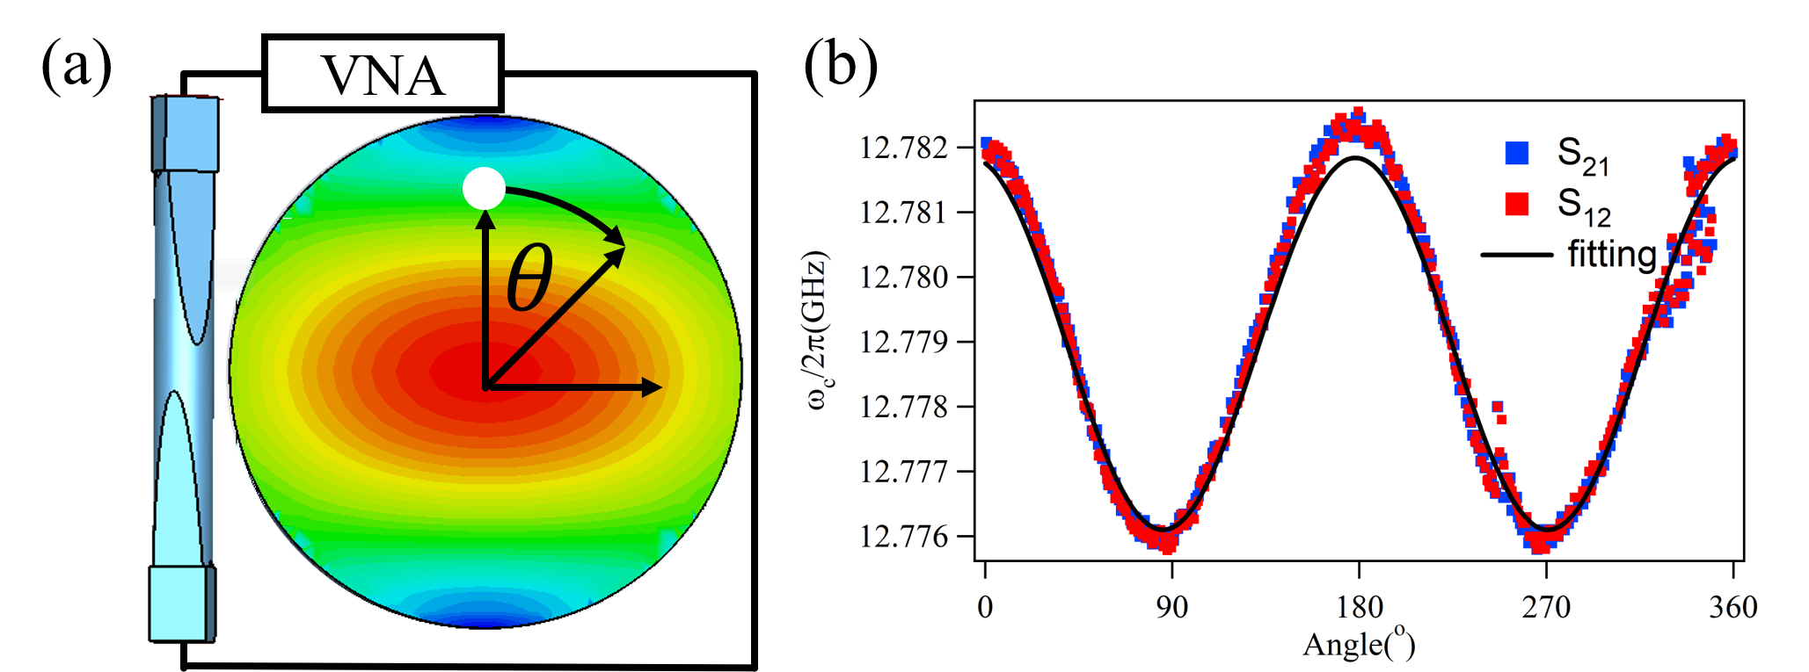

Experiment
Front view
$$φ$$
Top view

Slide 7
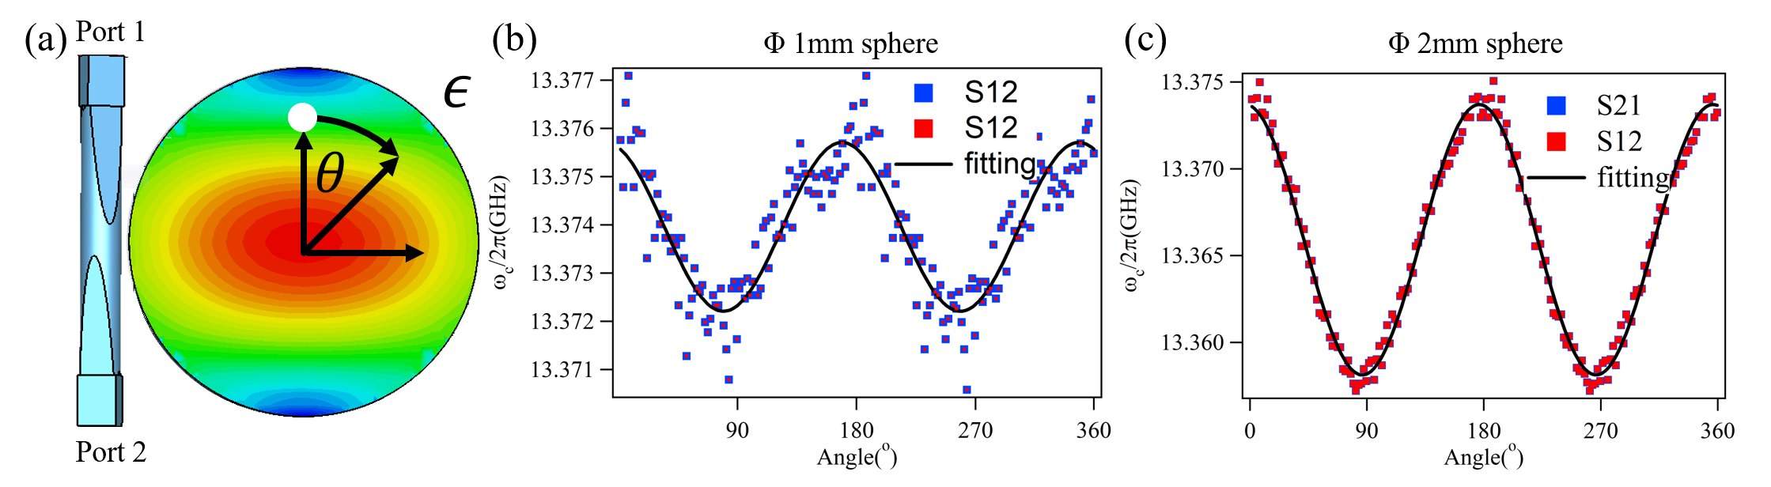
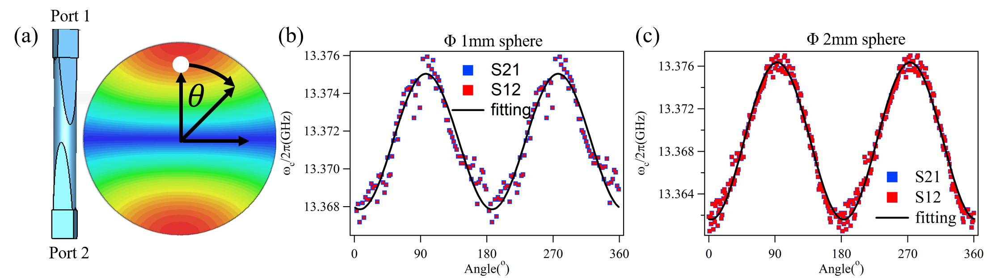
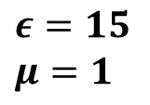
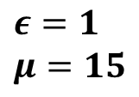
Simulations:
$$ε=1$$
$$μ=15$$
$$ε=15$$
$$μ=1$$

Slide 8
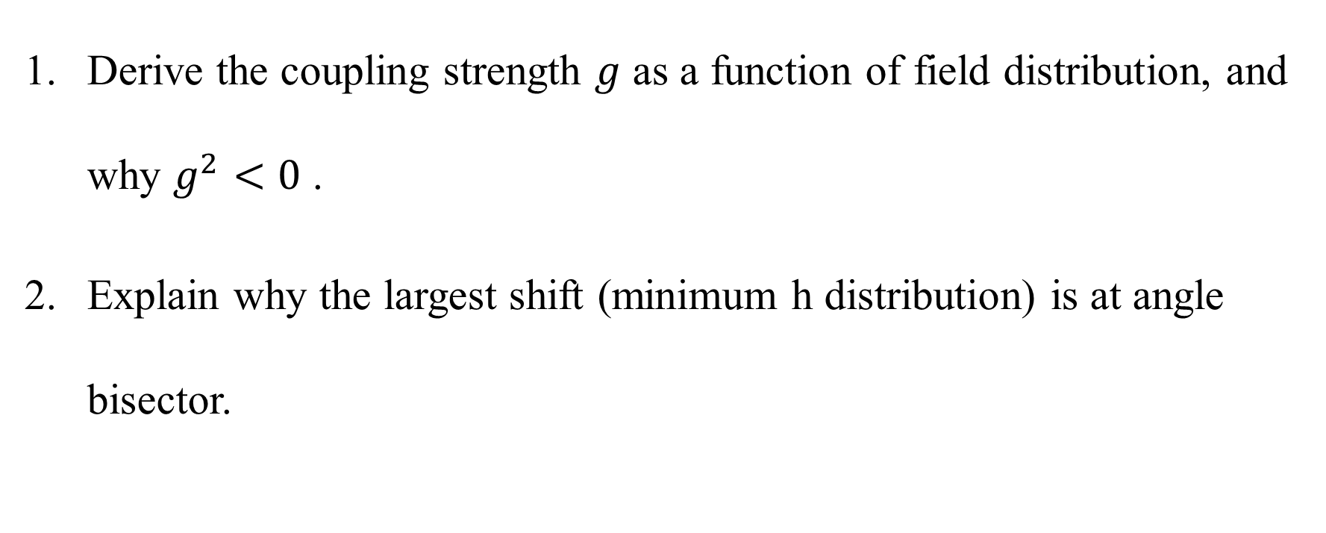
Next step:
Derive the coupling strength $g$ as a function of field distribution, and why $g^{2}<0$ .
Explain why the largest shift (minimum h distribution) is at angle bisector.

